Slide 1
Electrocardiogram: ECG/EKG
KIMIA YOUSEFIFARD
Prof Dr. ARTA JAMSHIDI

Slide 2
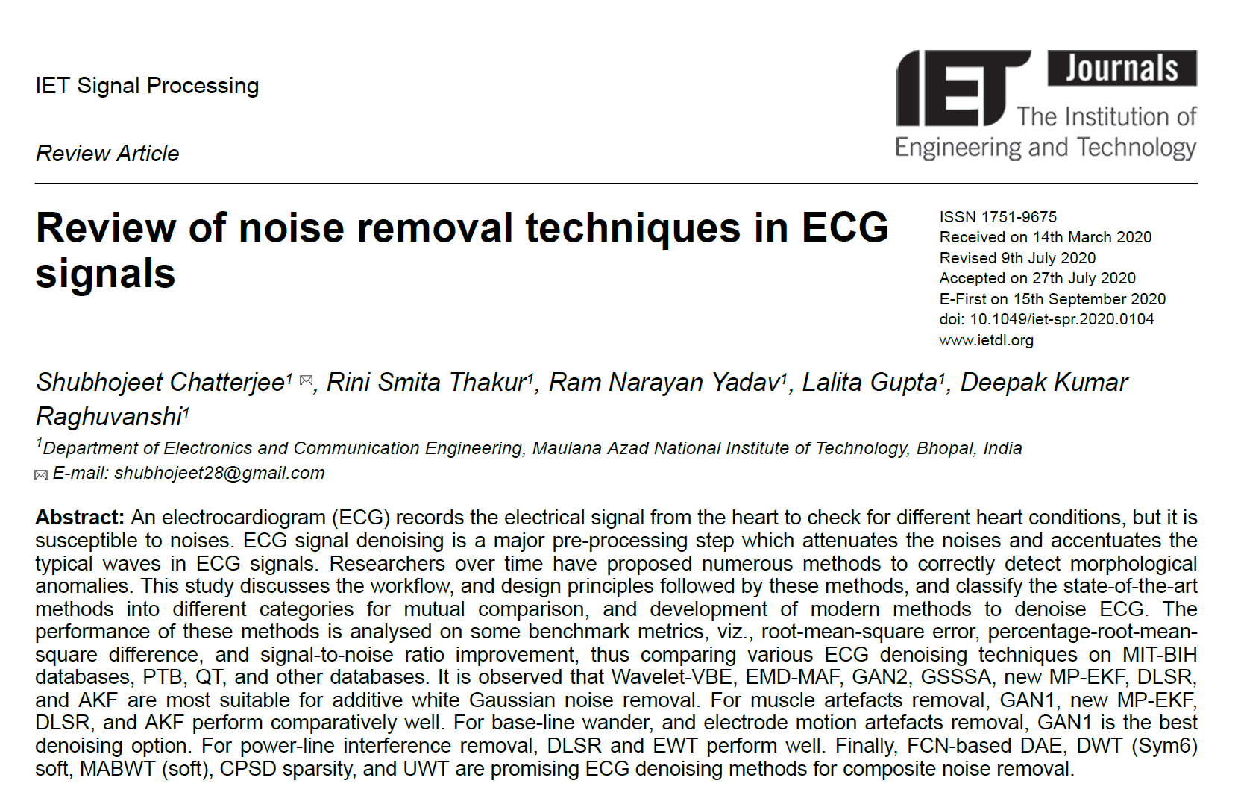

Slide 3


Outline
1. Introduction to ECG and Its Importance:
1.1. What is an ECG?
1.2. Understanding the ECG
1.3. Importance of ECG in Healthcare:
1.4. Challenges with ECG Data
1.5. Conclusion: The Indispensable Nature of ECG
2. Noise Types in ECG Signals
2.1. Baseline Wander (BW)
2.2. Muscle Artifacts (Electromyographic Noise)
2.3. Electrode Motion Artifacts
2.4. Power Line Interference (PLI)
2.5. Channel Noise (Instrumentation Noise)
3. Review of ECG Denoising Techniques
3.1. Empirical Mode Decomposition (EMD)
3.2. Deep Learning-Based Autoencoders (DAEs)
3.3. Wavelet Transform Methods
3.4. Sparsity-Based Methods
3.5. Bayesian Filtering Techniques

Slide 4
1. Introduction
An electrocardiogram or ECG is a tool used to visualize the electricity that flows through the heart. it specifically shows how the depolarization wave moves during each heartbeat.

Slide 5
1.1 What is an ECG?
An ECG is a graphical representation of the electrical impulses that trigger heart muscle contractions, producing a heartbeat.
The ECG machine captures electrical signals by placing electrodes on the skin in specific locations, translating them into waveforms recorded on paper or displayed on a screen.

Slide 6

Function of ECG
diagnosis of cardiac abnormalities of the patient
Diagnosing and determining the response of the patient's body to cardiac drugs
Determining the extent of heart function changes

Slide 7
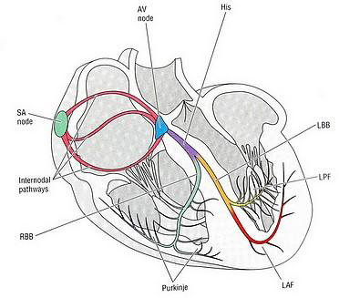
Cardiac conduction system

Slide 8
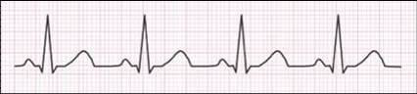
1.2 Understanding the ECG
The ECG waveform is characterized by a series of peaks and valleys, each representing different phases of the cardiac cycle.

Slide 9
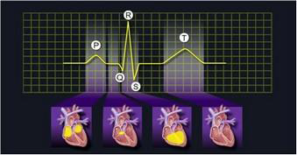
P wave: This signifies atrial depolarization, in which the heart's atria contract to push blood into the ventricles.
QRS complex: Denotes ventricular depolarization, the primary force behind the contraction of the ventricles, propelling blood to the lungs and the rest of the body. This phase is crucial for the heart’s pumping function.
T wave: Indicates ventricular repolarization, a recovery phase preparing the ventricles for the next contraction.

Slide 10
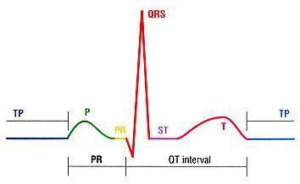
When analyzed together, these components provide a comprehensive overview of the heart's electrical rhythm, rate, and health, including any arrhythmias or abnormalities
PR Interval: The PR interval represents the time it takes for the electrical impulse to travel from the atria (the upper chambers of the heart) to the ventricles (the lower chambers of the heart).
QT Interval: The QT interval represents the total time it takes for ventricular depolarization and repolarization to occur.

Slide 11
1.3 Importance of ECG in Healthcare:
The ECG's role in healthcare is multifaceted, offering diagnostic and monitoring capabilities essential for identifying and managing various cardiac conditions. It's especially critical in diagnosing:
Arrhythmias: Irregular heartbeats can lead to complications if not properly managed.
Ischemic heart disease: This includes myocardial infarctions (heart attacks), where the ECG can identify areas of the heart with reduced blood flow.
Cardiomyopathy: Changes in heart muscle that can affect the heart’s ability to pump bloodeffectively.
Electrolyte imbalances and medication impacts: Which can alter the heart's electrical activity.

Slide 12
Causes of cardiac arrhythmias
01
02
03
Stress
Electrolyte Imbalance
Thyroid Disorders
04
05
06
Chronic Illness
Drug Abuse
Medication
Anxiety and emotional stress can trigger abnormal heart rhythms
Abnormal levels of electrolytes like potassium, magnesium, and calcium
Overactive and underactive thyroid glands
sepsis, myocarditis, heart failure, and electrolyte disturbances
cocaine abuse, alcohol abuse, Amphetamine Abuse
Some medications affecting the nervous system or electrolyte balance

Slide 13
Features of a Good Electrocardiogram (ECG)
Accuracy and Reliability
Ease of Use
Portability
Data Management
Connectivity
Battery Life
Patient Comfort

Slide 14
1.4 Challenges with ECG Data
Despite its numerous benefits, the interpretation of ECG data is not without challenges.
One of the primary obstacles is noise—unwanted signals that can distort the accurate ECG waveform.

Slide 15
The cause of these noises
muscle tremors or contractions
Electrode motion artifacts
electrical interference from equipment
Baseline Wandering Noise

Slide 16
2. Noise Types in ECG Signals

Slide 17
Baseline Wander (BW)
Muscle Artifacts (MA)
Power Line Interference (PLI)
Channel Noise (Instrumentation Noise)

Slide 18
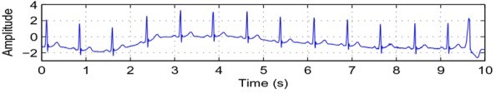
2.1 Baseline Wander (BW)
Causes:
Baseline wander often results from physiological factors such as patient breathing, adjustments in posture, or improper electrode placement. It can also be influenced by changes in electrode-skin impedance over time.
Characteristics:
This type of noise manifests as a slow, meandering shift in the ECG's baseline. It predominantly affects the signal's lower frequency components.
Impact on ECG:
BW can severely distort the interpretation of the ST segment, which is crucial for diagnosing myocardial ischemia. It may also affect the visibility of smaller waves, such as the P and T waves, complicating the atrial and ventricular health assessment.

Slide 19
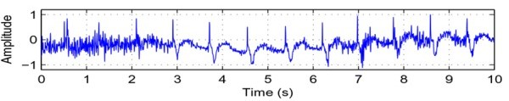
2.2 Muscle Artifacts (Electromyographic Noise)
Causes:
Muscle artifacts arise from electrical activities in the muscles, mainly when these muscles are near the electrodes. Common causes include patient movement, shivering, or tension during the ECG recording.
Characteristics:
This random, sharp noise introduces erratic spikes and variations that overlay the accurate ECG signal. It exhibits a broad frequency spectrum, often overlapping with the frequency of cardiac signals.
Impact on ECG:
Muscle artifacts can simulate arrhythmic events or obscure true abnormalities, making diagnosis of conditions like arrhythmias or conduction blockages challenging.

Slide 20
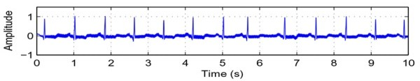
2.3 Power Line Interference (PLI)
Causes:
PLI results from the electrical activity of surrounding equipment and infrastructure, mainly the 50/60 Hz frequency from power lines and medical devices near the ECG recording setup.
Characteristics:
It appears as a continuous, sinusoidal wave superimposed across the ECG tracing and consistent in frequency and amplitude throughout the recording.
Impact on ECG:
PLI can obscure fine details in the ECG waveform, such as the ST segment, potentially complicating or leading to misinterpretation of ischemic conditions or other subtle waveform features.

Slide 21
2.4 Channel Noise (Instrumentation Noise)
Causes:
Channel noise includes the random electronic noise produced by the components of the ECG recorder itself, such as thermal noise in electrical circuits or fluctuations in digital processing elements.
Characteristics:
This type of noise is characterized by high-frequency static or "speckle" that overlays the ECG waveform, reducing the clarity of the signal.
Impact on ECG:
It can diminish the clarity of smaller diagnostic features such as the U wave or complicate the accurate measurement of interval durations and amplitudes.

Slide 22
3. Review of ECG Denoising Techniques

Slide 23
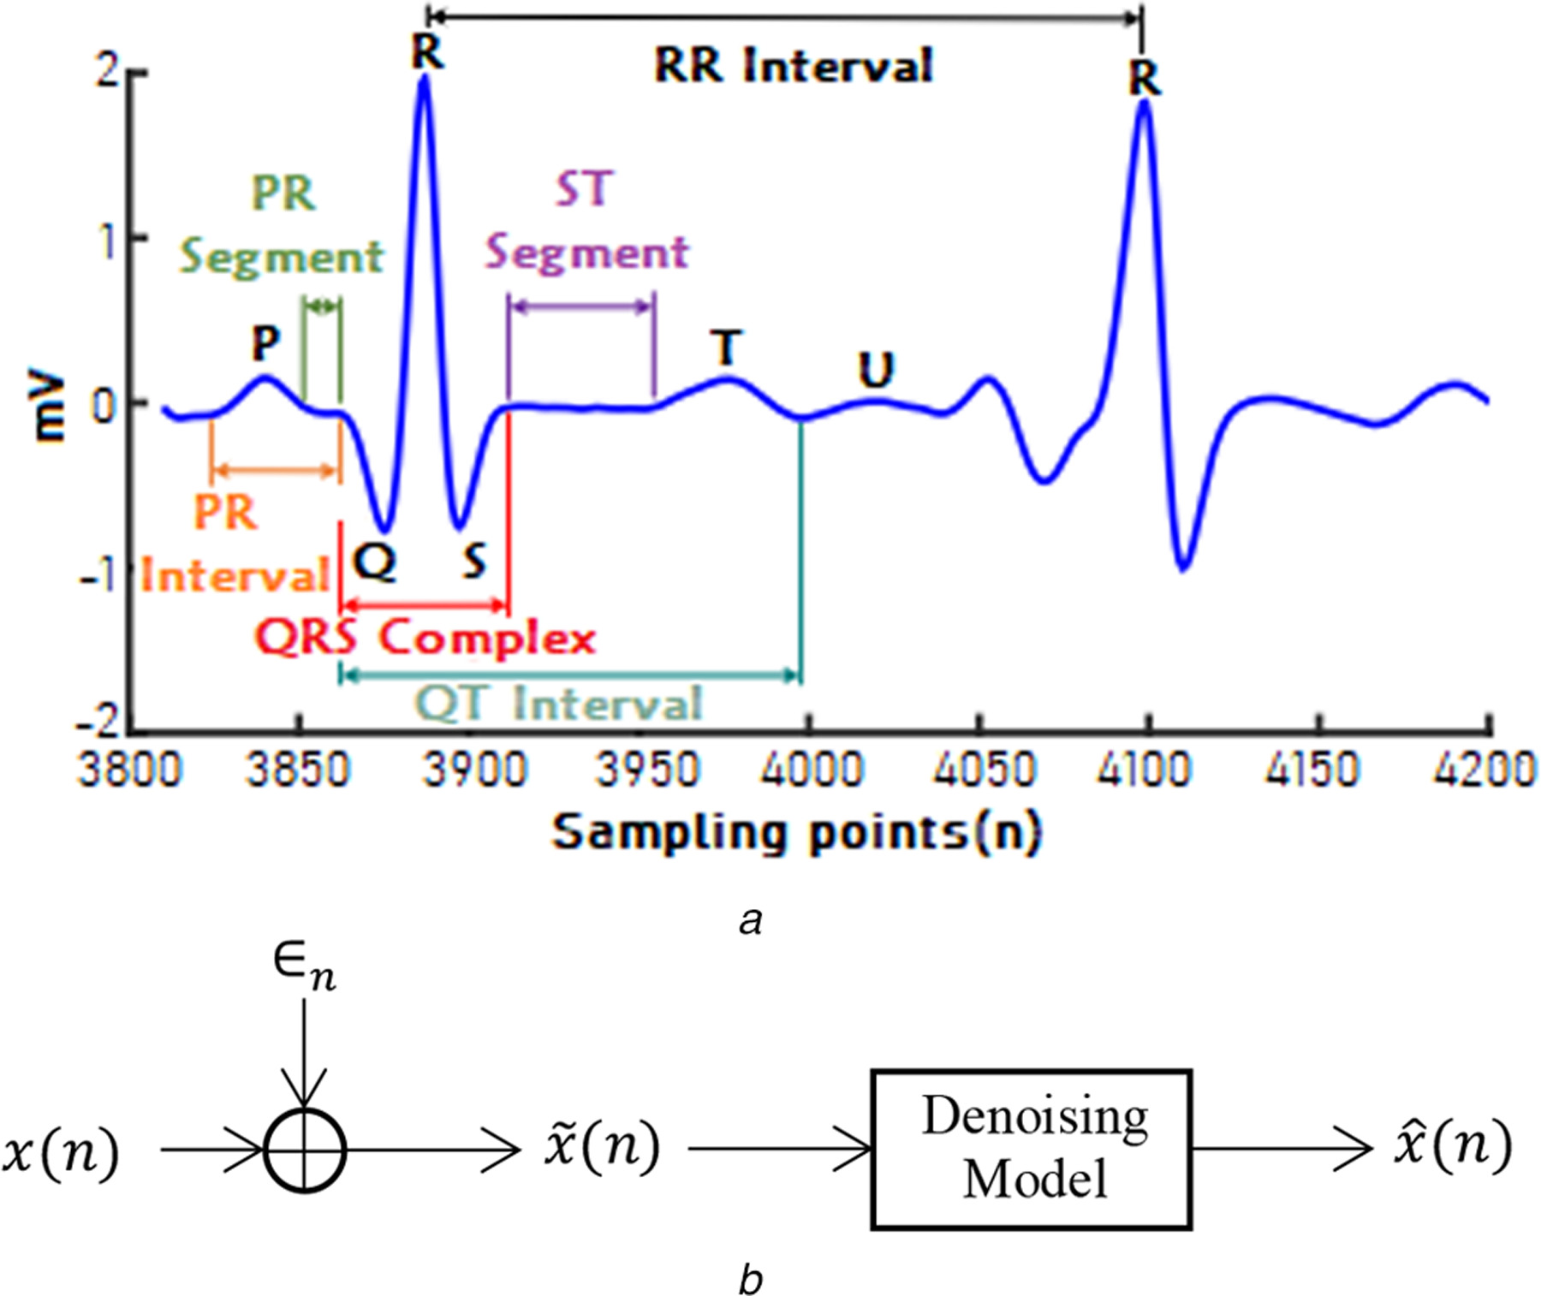

Slide 24
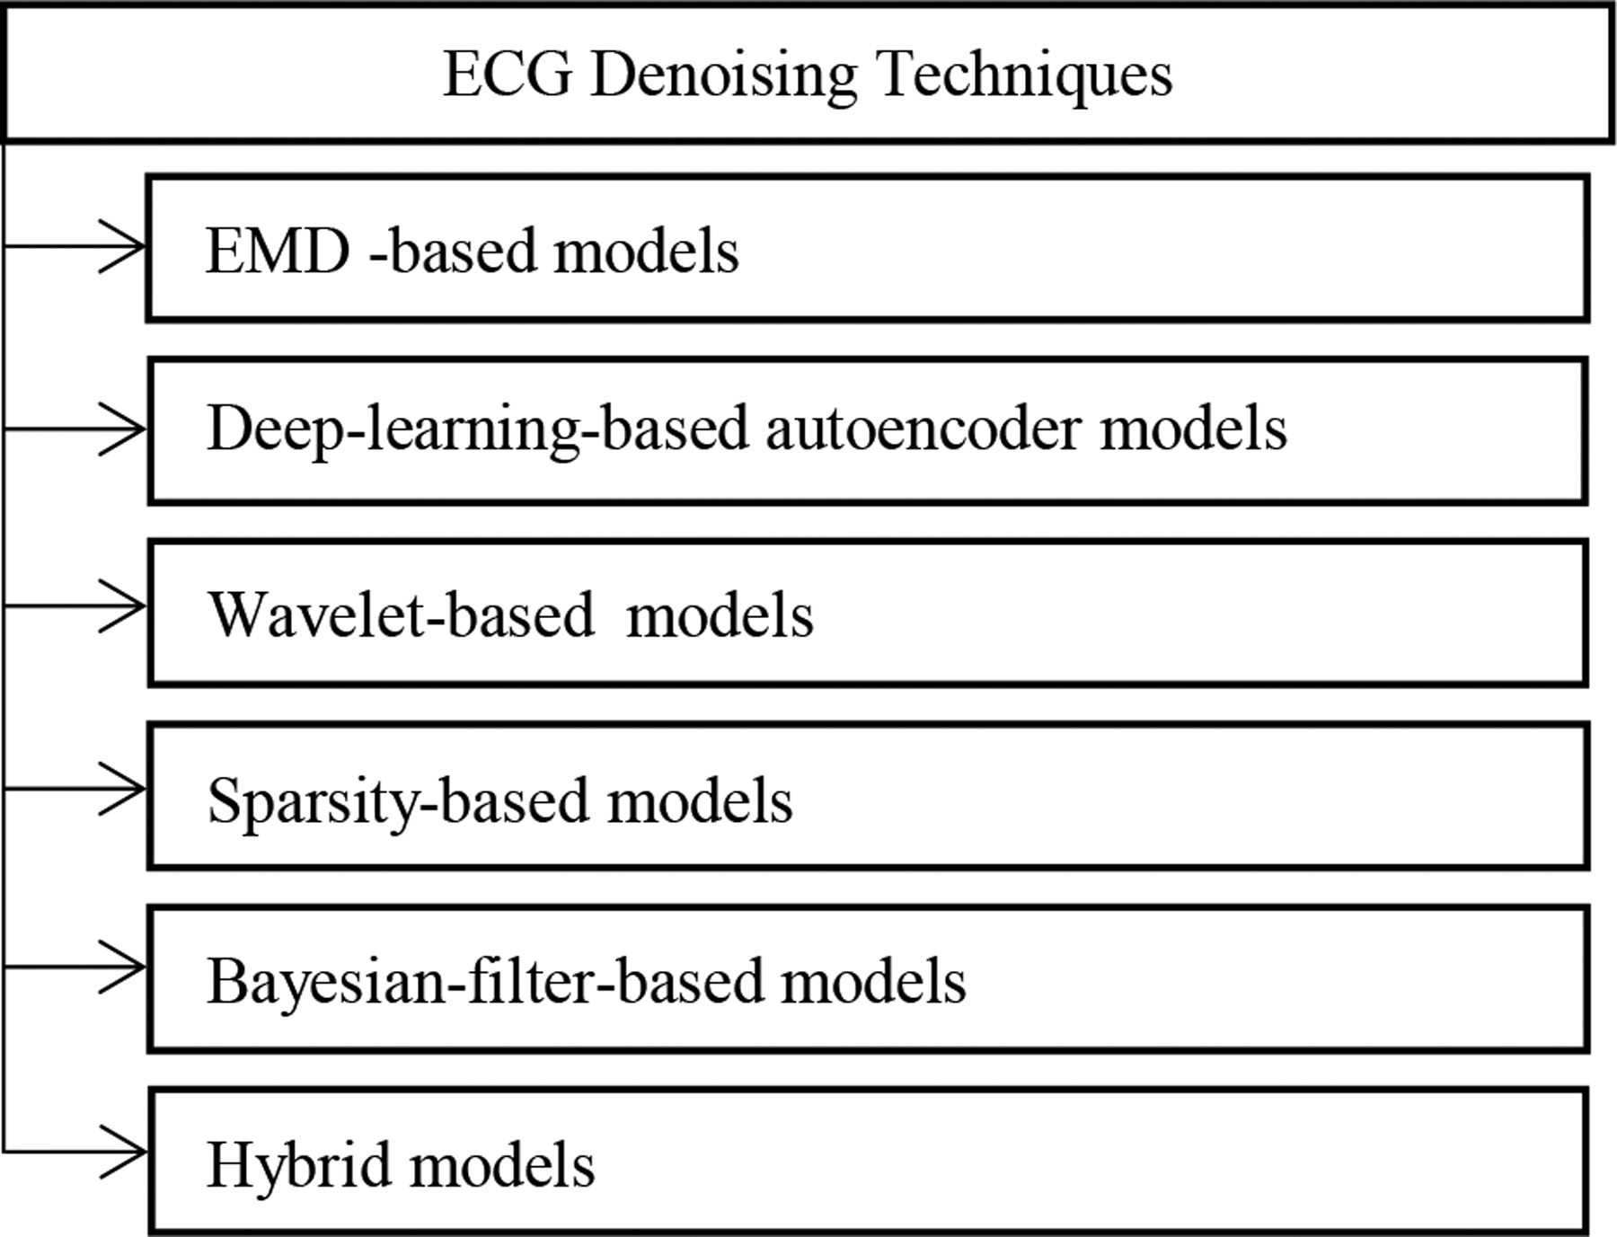

Slide 25
3.1 Empirical Mode Decomposition (EMD)

Slide 26
3.1 Empirical Mode Decomposition (EMD)
Separate signal into different components to gain new insight into the inherent features

Slide 27
3.1 Empirical Mode Decomposition (EMD)
Separate signal into different components to gain new insight into the inherent features
Portion of the complete signal

Slide 28
3.1 Empirical Mode Decomposition (EMD)
Separate signal into different components to gain new insight into the inherent features
Portion of the complete signal
Signal dictates decomposition.
Adaptive basis system

Slide 29
3.1 Empirical Mode Decomposition (EMD)
Separate signal into different components to gain new insight into the inherent features
Portion of the complete signal
Signal dictates decomposition.
Adaptive basis system
Objective: data decomposition to obtain components of the data which help you analyze/understand data inherent features.

Slide 30
Properties of EMD
Ability to process non-linear and non-stationary data
basis system dictated by data (no prescribed system)
- modes adaptively based towards locally dominant and frequencies/scales
- Physically meaningful modes

Slide 31
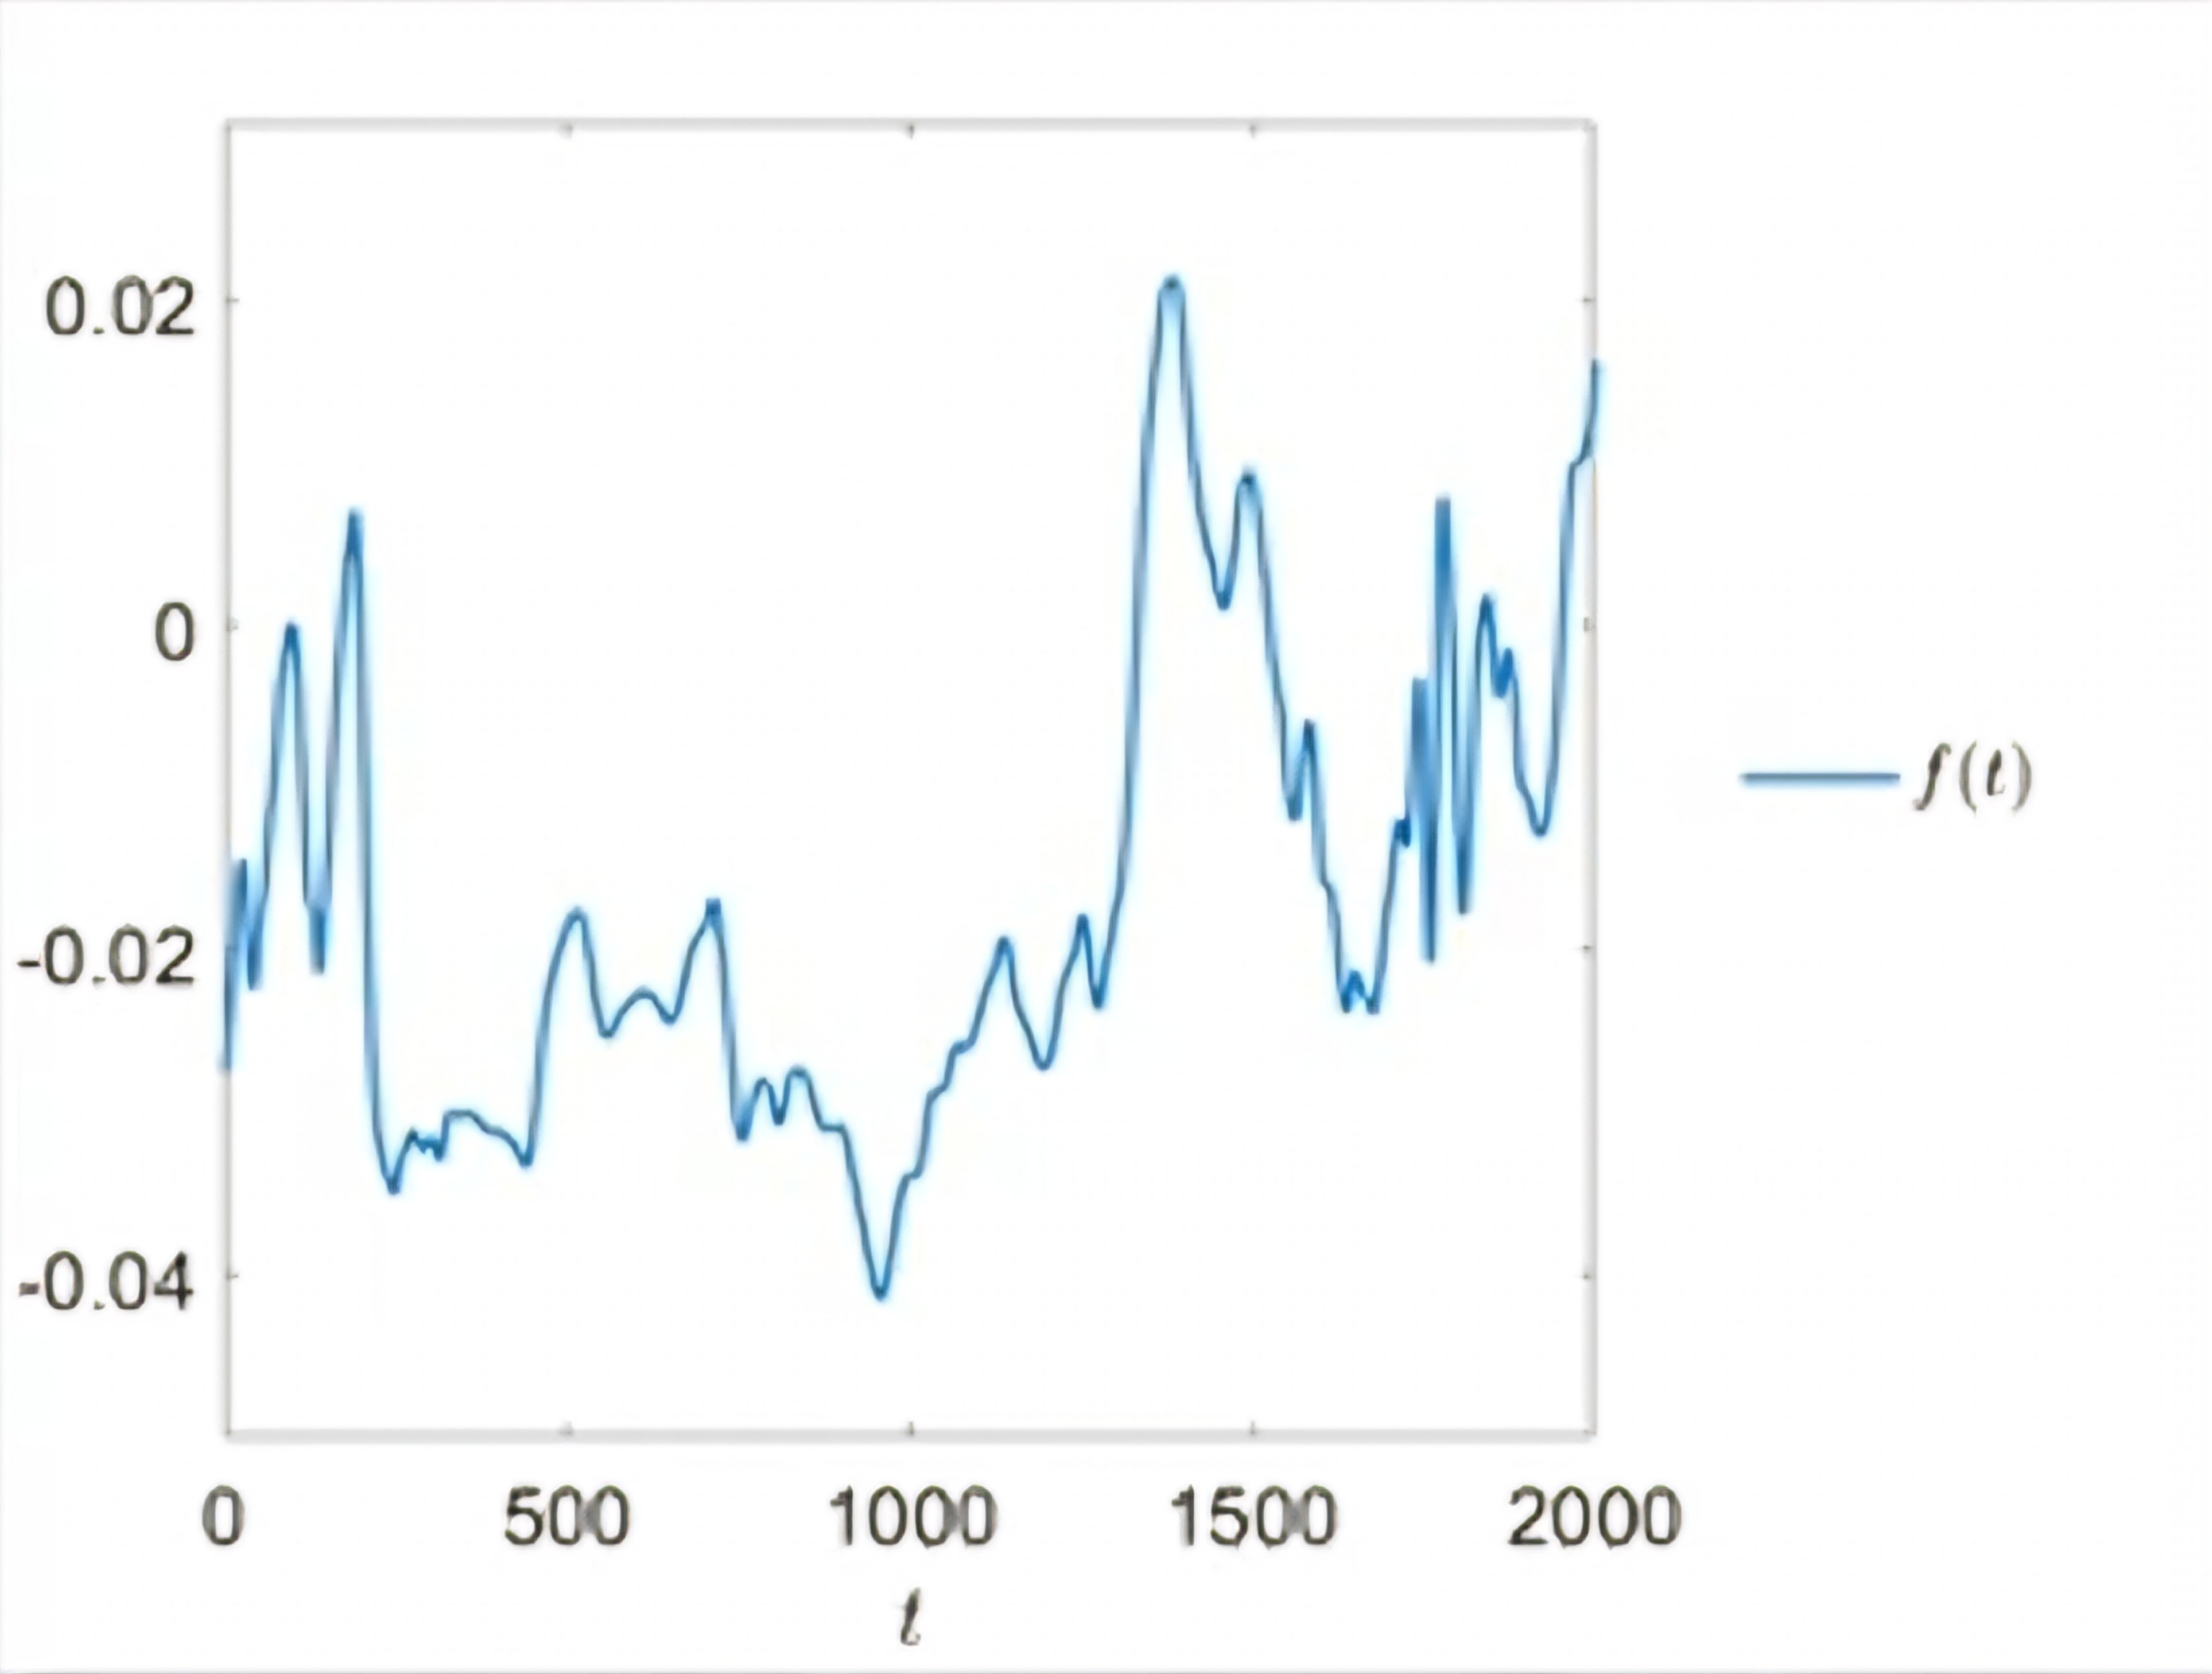
The starting point
Of the one-dimensional univariate EMD
Starting point:
A one one-dimensional univariate signal f(t)

Slide 32
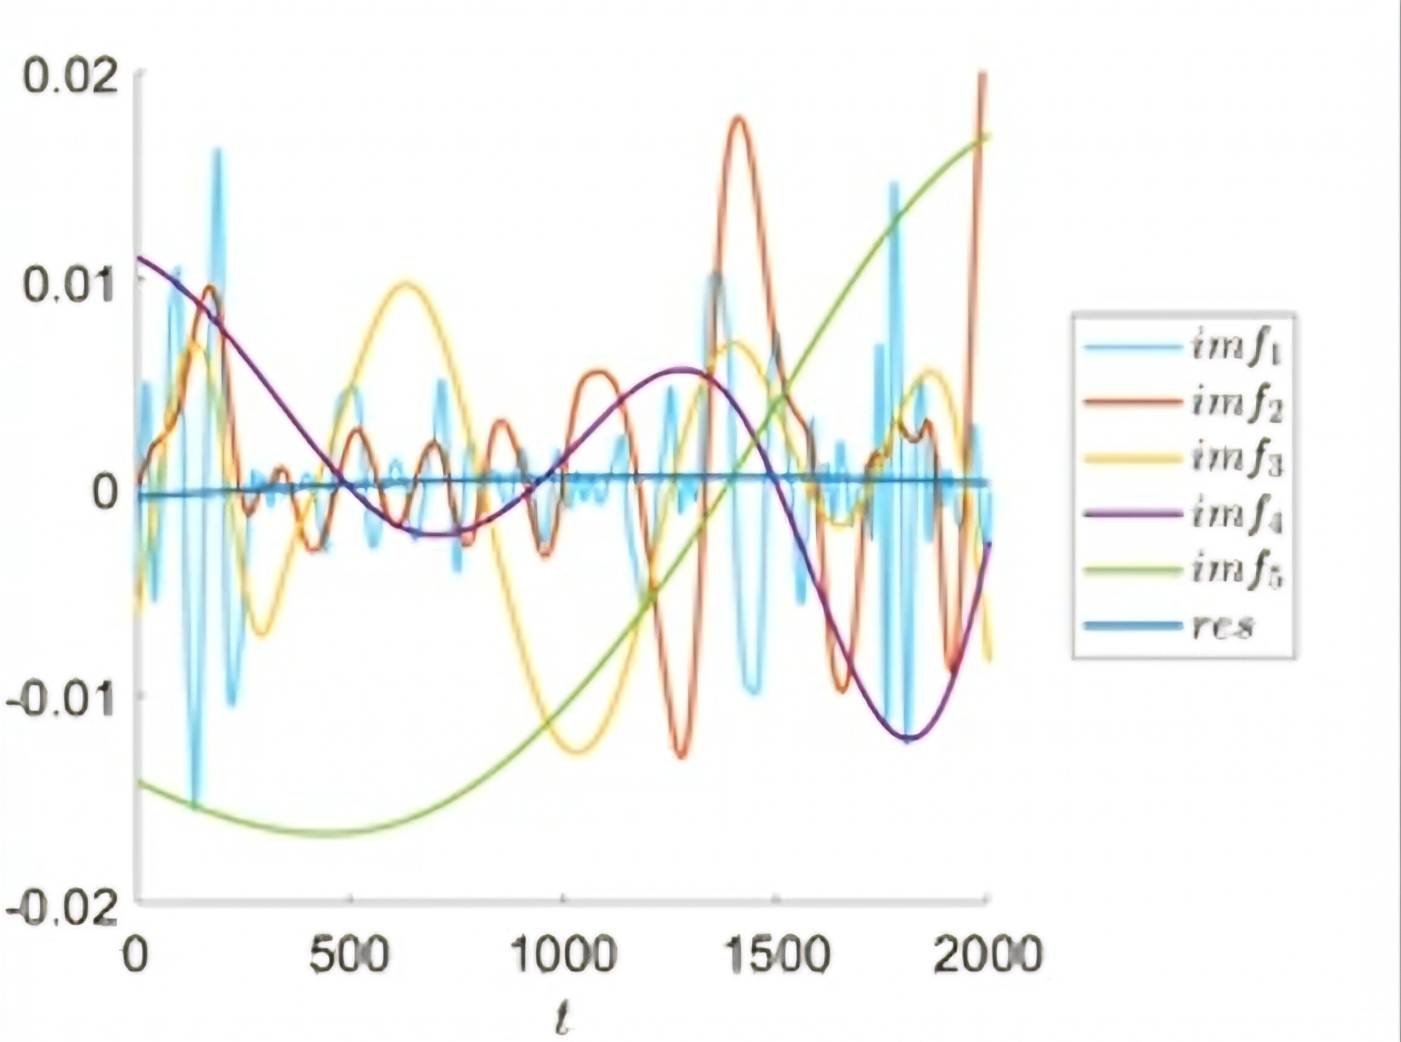
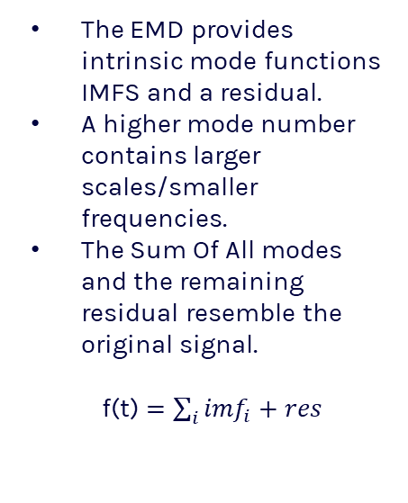
The outcome
Of the one-dimensional univariate EMD
The EMD provides intrinsic mode functions IMFS and a residual.
A higher mode number contains larger scales/smaller frequencies.
The Sum Of All modes and the remaining residual resemble the original signal.
f(t) $=\sum_{i}{{imf}_{i}}+res$

Slide 33
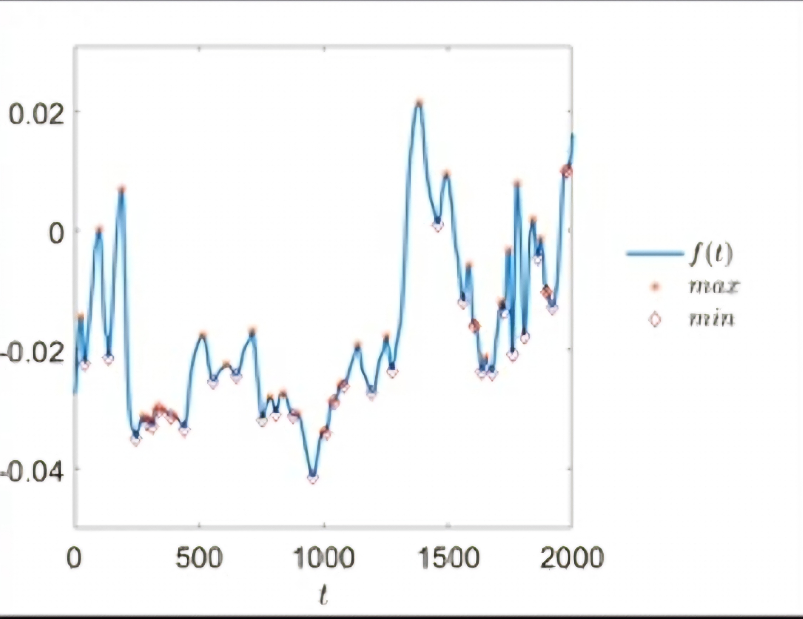
High-level overview
of the one-dimensional univariate EMD
Find local extrema of the signal

Slide 34
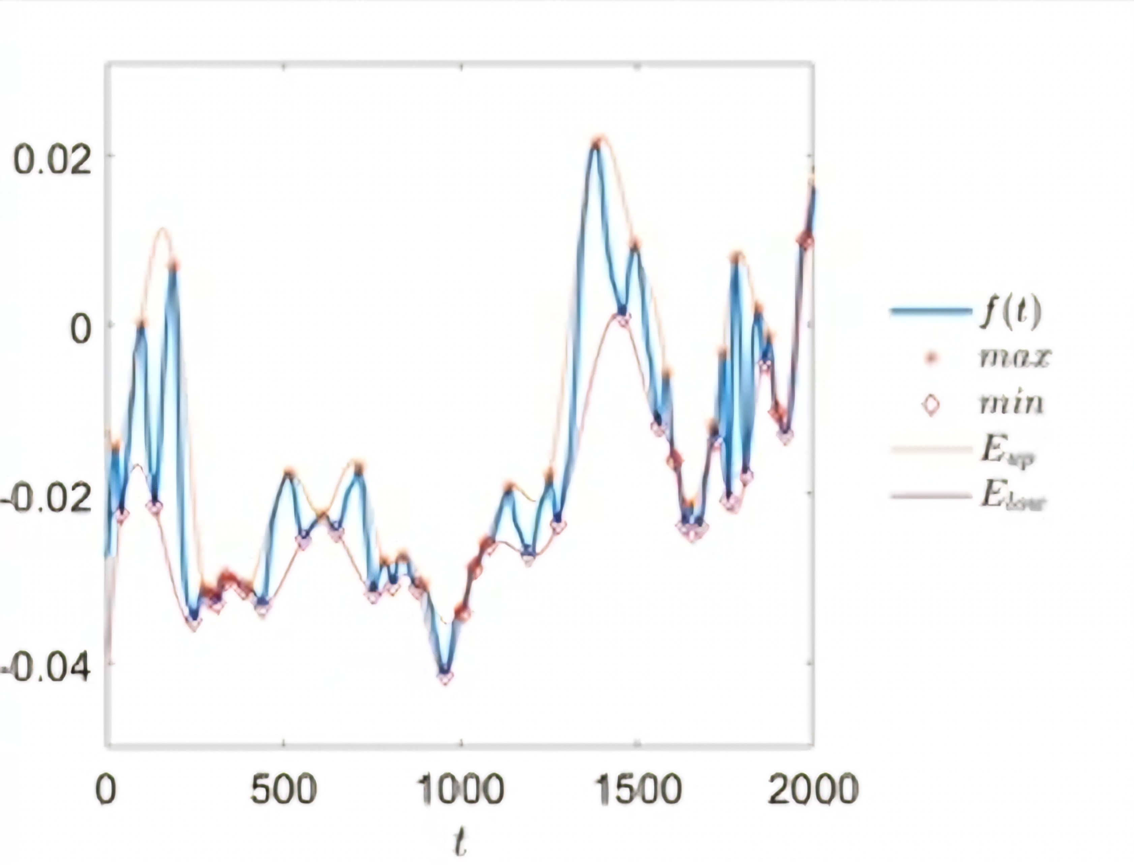
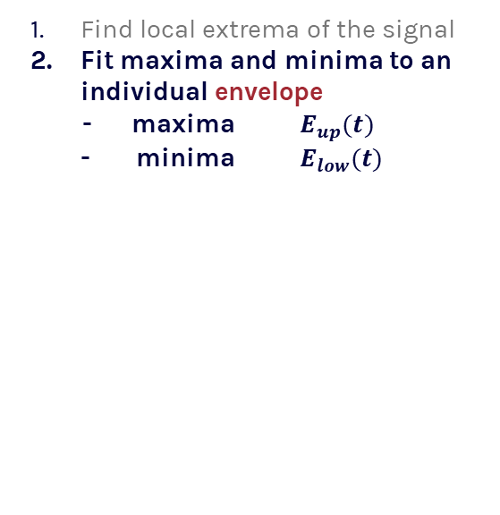
High-level overview
of the one-dimensional univariate EMD
Find local extrema of the signal
Fit maxima and minima to an individual envelope
- maxima $E_{up}(t)$
- minima $E_{low}(t)$

Slide 35
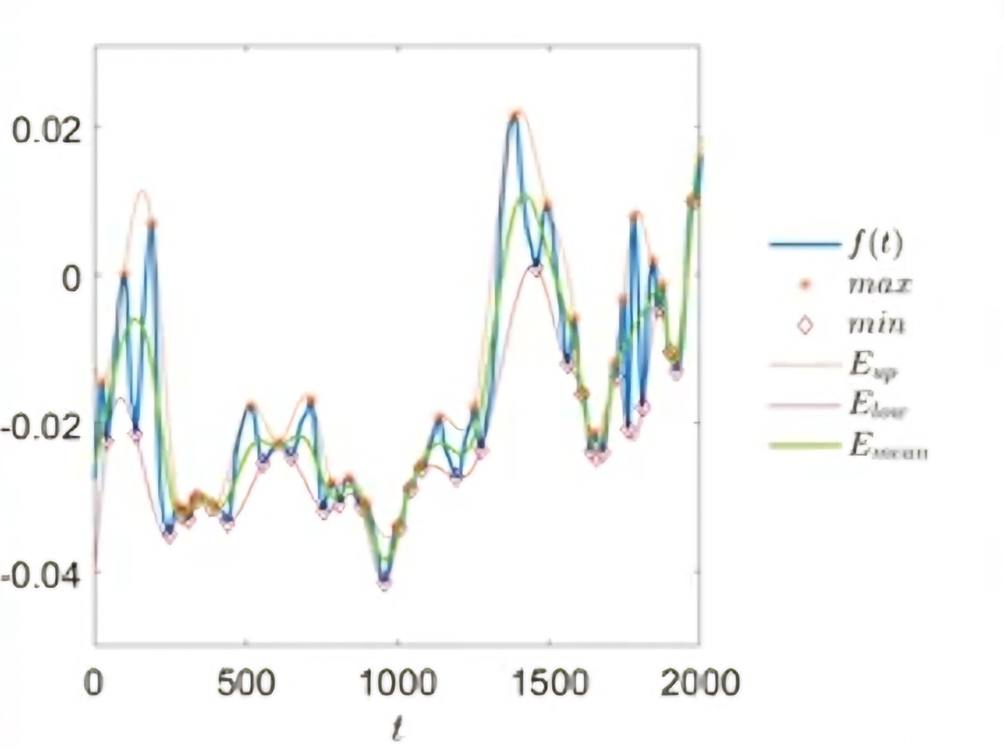
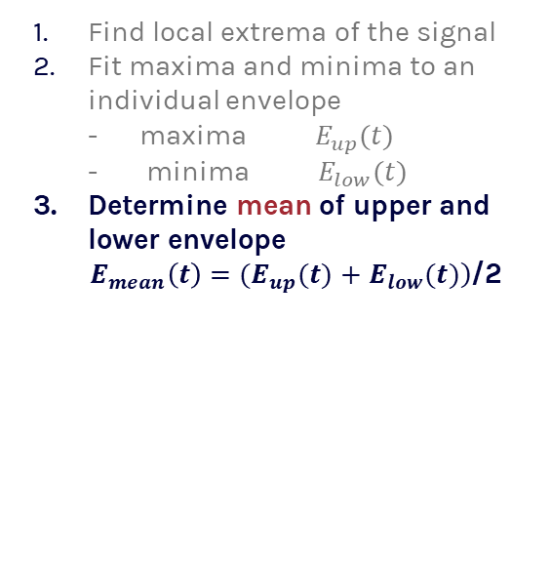
High-level overview
of the one-dimensional univariate EMD
Find local extrema of the signal
Fit maxima and minima to an individual envelope
- maxima $E_{up}(t)$
- minima $E_{low}(t)$
Determine mean of upper and lower envelope
$E_{mean}\left(t\right)=(E_{up}(t)$ $+$ $\left.E_{low}(t)\right)$/2

Slide 36
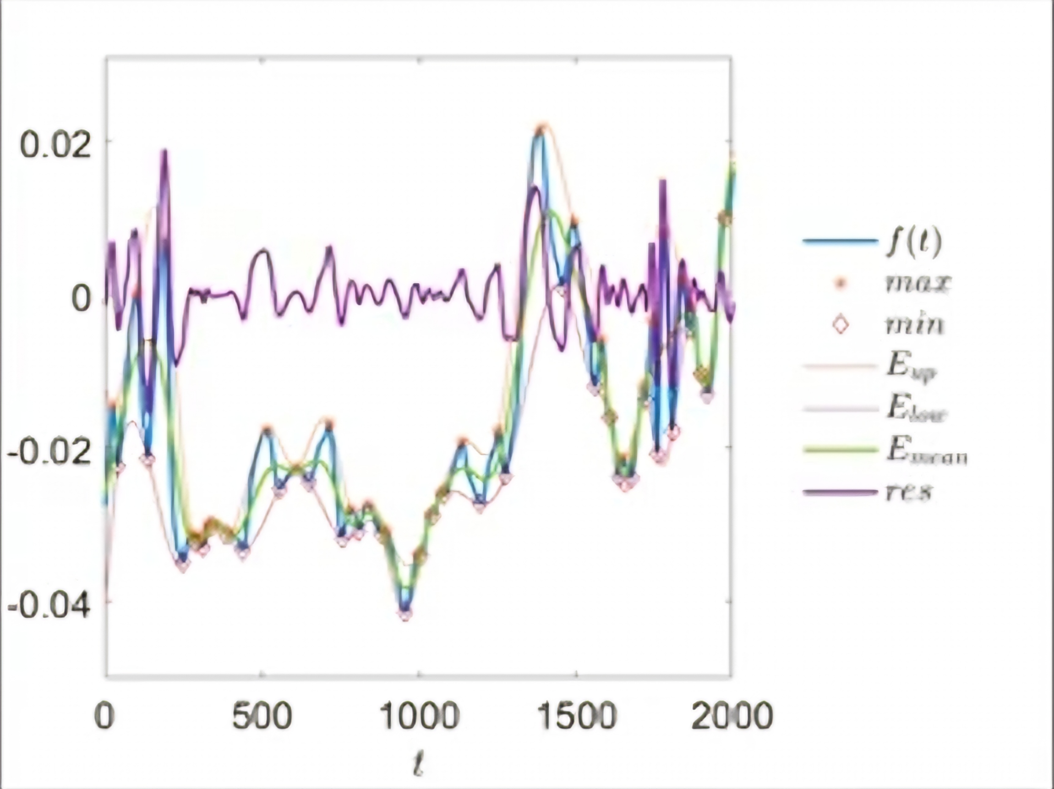
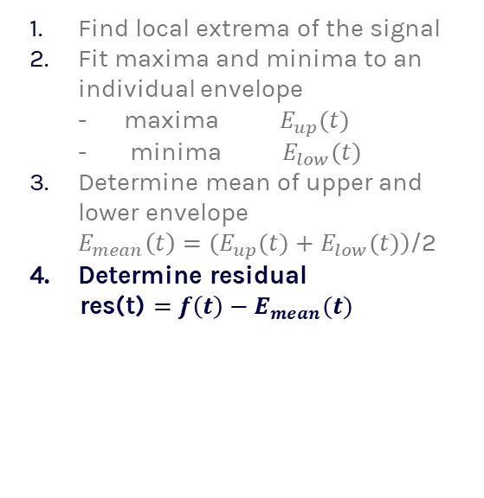
High-level overview
of the one-dimensional univariate EMD
Find local extrema of the signal
Fit maxima and minima to an individual envelope
- maxima $E_{up}(t)$
- minima $E_{low}(t)$
Determine mean of upper and lower envelope
$E_{mean}\left(t\right)=(E_{up}(t)$ $+$ $\left.E_{low}(t)\right)$/2
Determine residual
res(t) $=$ $f\left(t\right)−E_{mean}(t)$

Slide 37
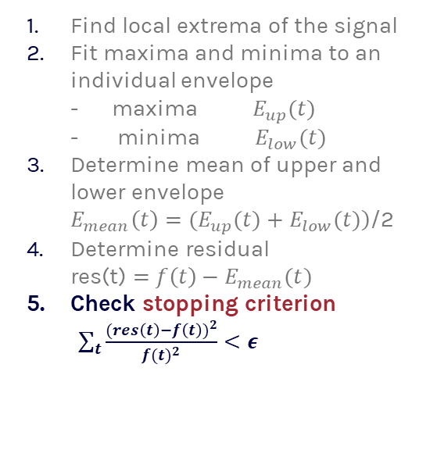
High-level overview
of the one-dimensional univariate EMD
Find local extrema of the signal
Fit maxima and minima to an individual envelope
- maxima $E_{up}(t)$
- minima $E_{low}(t)$
Determine mean of upper and lower envelope
$E_{mean}\left(t\right)=(E_{up}(t)$ $+$ $\left.E_{low}(t)\right)$/2
Determine residual
res(t) $=$ $f\left(t\right)−E_{mean}(t)$
Check stopping criterion
$\sum_{t}{\frac{{(res\left(t\right)−f\left(t\right))}^{2}}{{f(t)}^{2}}}<ε$

Slide 38
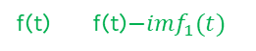
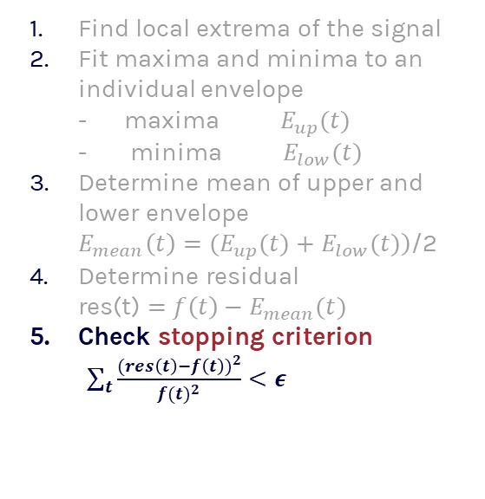
High-level overview
of the one-dimensional univariate EMD
f(t) f(t)$−{imf}_{1}(t)$
res(t)
Find local extrema of the signal
Fit maxima and minima to an individual envelope
- maxima $E_{up}(t)$
- minima $E_{low}(t)$
Determine mean of upper and lower envelope
$E_{mean}\left(t\right)=(E_{up}(t)$ $+$ $\left.E_{low}(t)\right)$/2
Determine residual
res(t) $=$ $f\left(t\right)−E_{mean}(t)$
Check stopping criterion
$\sum_{t}{\frac{{(res\left(t\right)−f\left(t\right))}^{2}}{{f(t)}^{2}}}<ε$
Iterate until residual possesses IMF characteristics
Iterate until all IMFs are extracted from the signal
When do we stop the decomposition?
It stops when the residual approach a monotonic function
If true
If false

Slide 39
3.2 Deep Learning-Based Autoencoders (DAEs)
Principle:
Effectiveness:
Deep Learning-Based Autoencoders are a class of neural networks designed for learning efficient codings by training the network to ignore signal "noise." DAEs are trained to reconstruct the input from a corrupted version, thereby learning to filter out the noise.
DAEs have proven highly effective in environments where noise characteristics vary significantly, such as ambulatory ECG monitoring. They adapt well to new types of noise through additional training, making them very versatile.

Slide 40
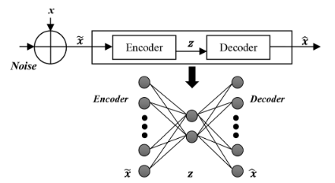
autoencoders:
encoder : conversion one type of data into another type of data for the ease of transmission, communication and storing.
code : lower dimensional representation of input data.
Decoder : reconstruct our input data from lower dimensional representation.

Slide 41
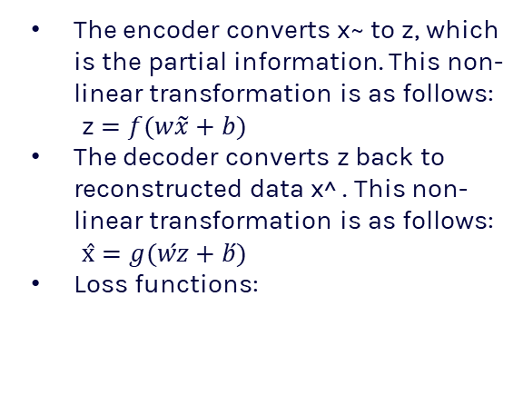
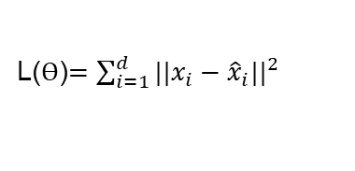
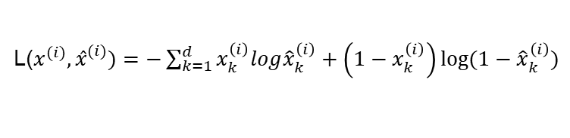
steps:
The encoder converts x~ to z, which is the partial information. This non-linear transformation is as follows:
z $=f(w\tilde{x}+b)$
The decoder converts z back to reconstructed data x^ . This non-linear transformation is as follows:
$\text{x}̂=g(ẃz+b́)$
Loss functions:
L($x^{(i)},{x̂}^{(i)})=−\sum_{k=1}^{d}{x_{k}^{\left(i\right)}log{\hat{x}}_{k}^{\left(i\right)}+\left(1−x_{k}^{\left(i\right)}\right)log⁡(1−{\hat{x}}_{k}^{\left(i\right)}})$
L(Ө)$=\sum_{i=1}^{d}{{{||x}_{i}−{\hat{x}}_{i}||}^{2}}$

Slide 42
3.3 Wavelet Transform Methods
Principle:
Wavelet Transform provides a time-frequency representation of the signal and is particularly adept at isolating signal components at different scales. Denoising is achieved by altering the wavelet coefficients, which can effectively separate noise from the signal based on frequency content.
Decomposing into ECG signal and converting to different frequencies.
Identify and remove noise at each frequency.
Signal reconstruction without noise.

Slide 43
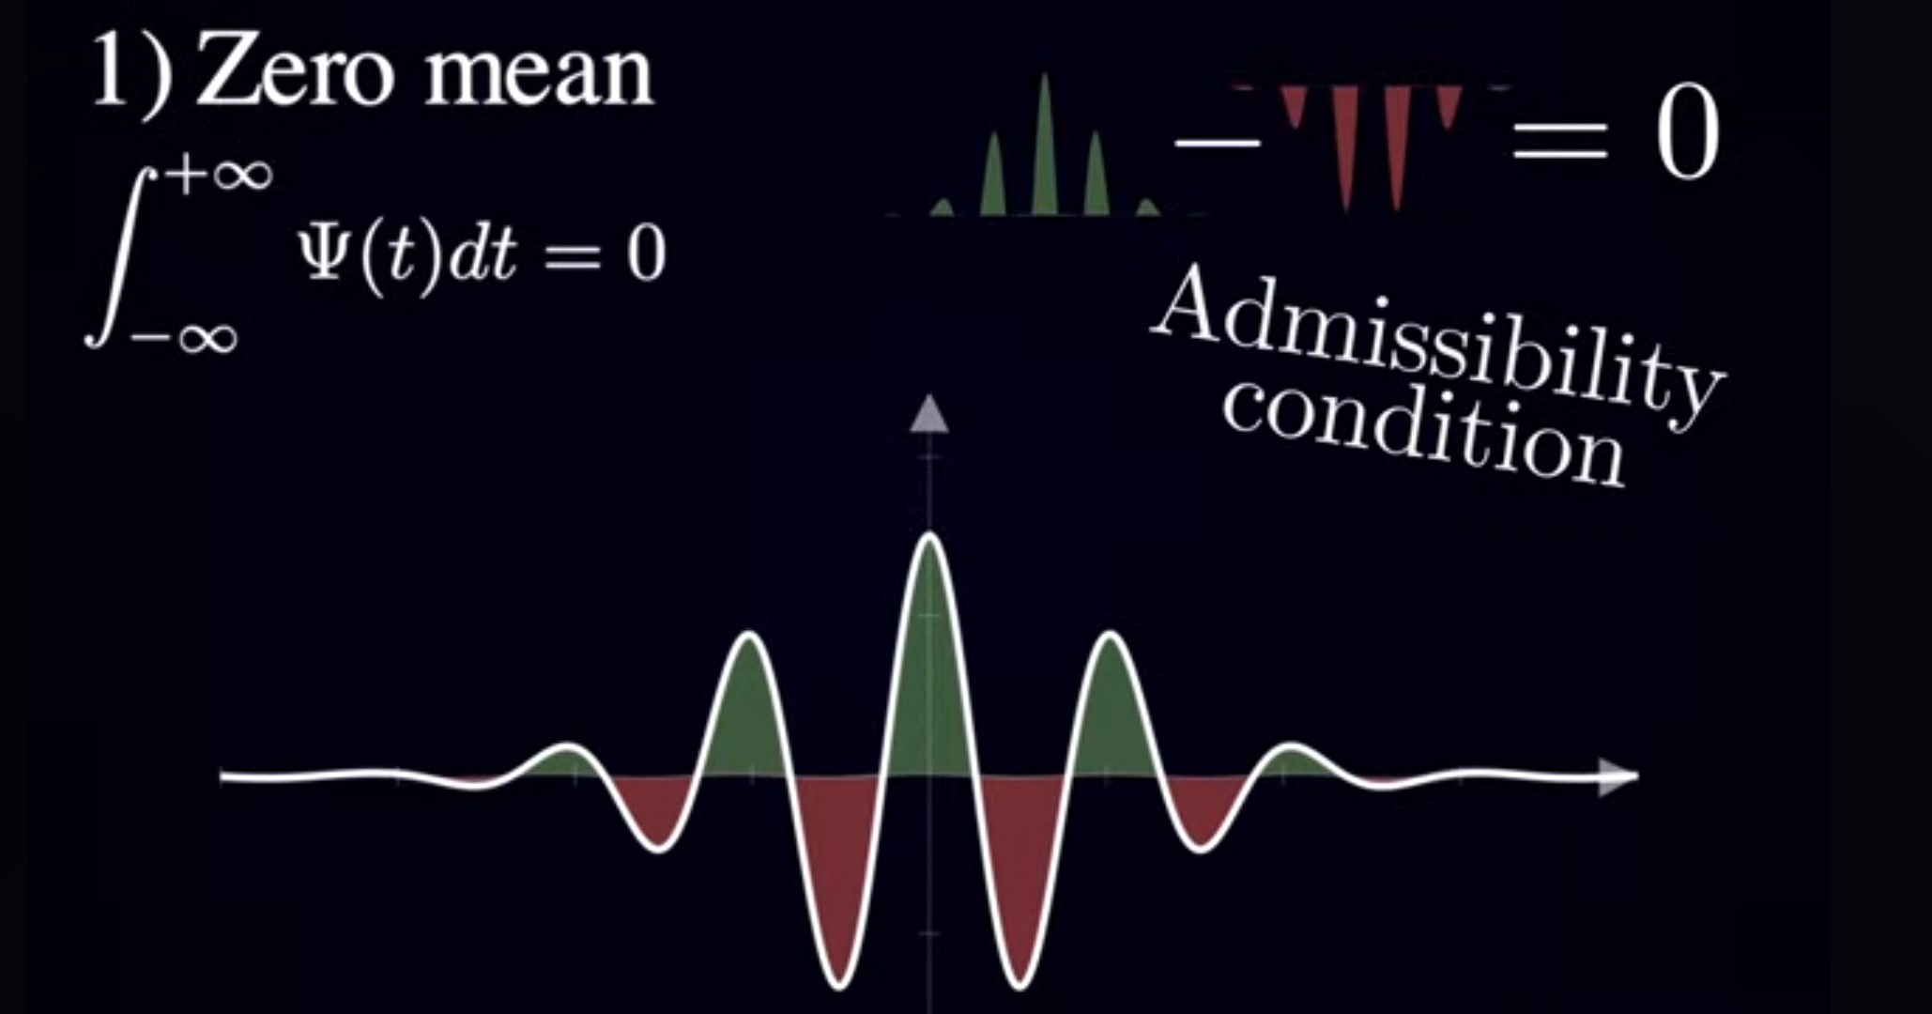

Slide 44
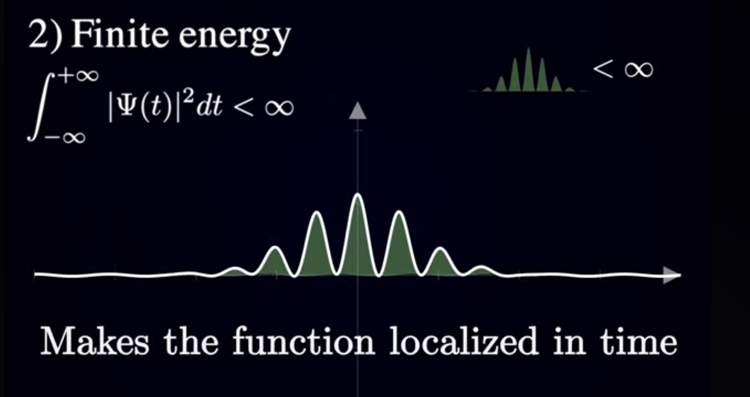

Slide 45
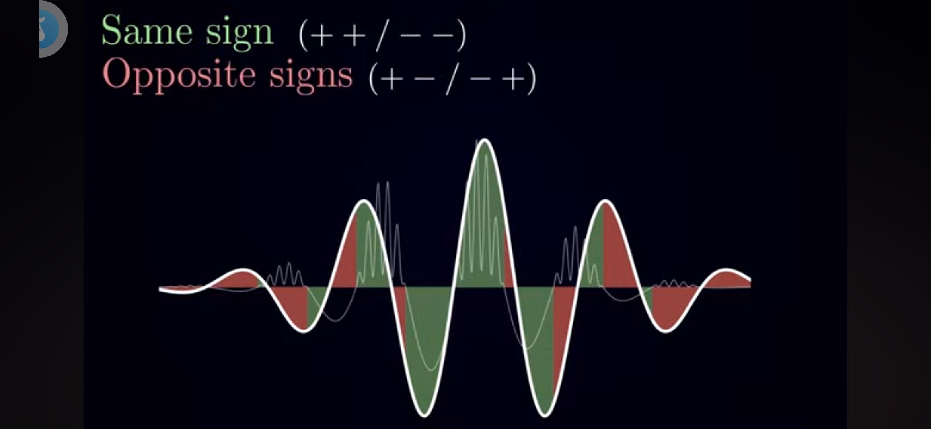
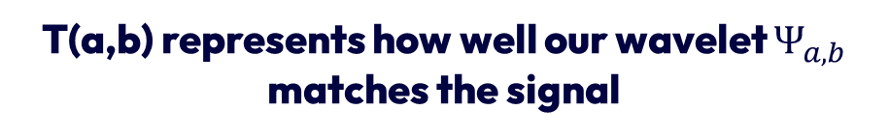
T(a,b) represents how well our wavelet $Ψ_{a,b}$ matches the signal
Goodness of fit: a measure how well our modifies wavelet matches the signal around that time point

Slide 46
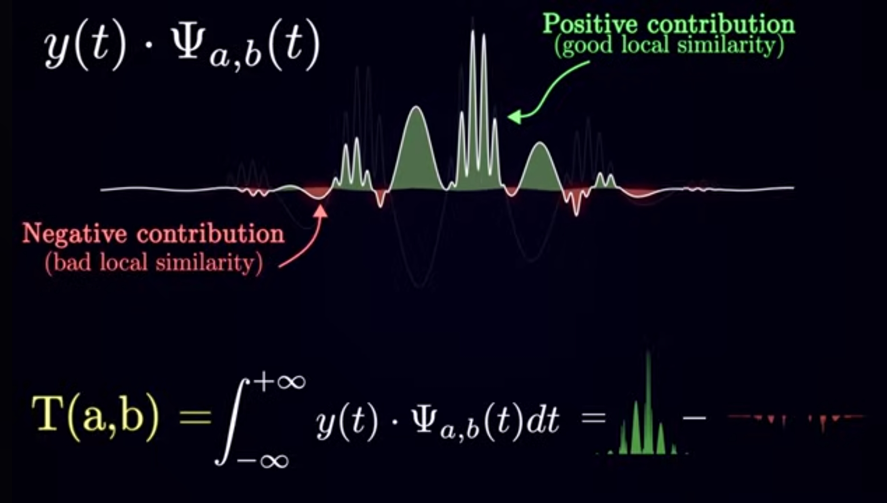

Slide 47
Sparsity-Based Methods

Slide 48
Bayesian Filtering Techniques

Slide 49
Thanks!

